Slide 1

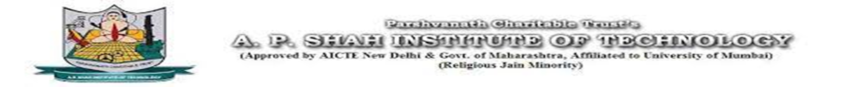

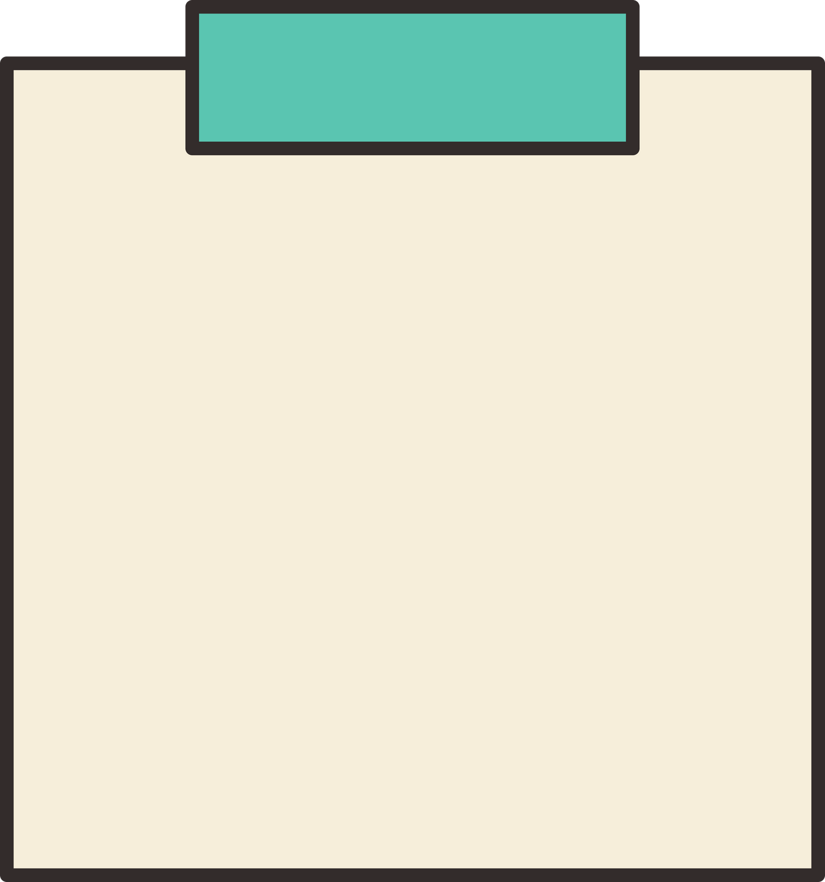
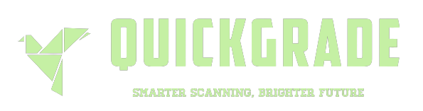

OMR SYSTEM
Team Members:
SAVINAY PANDEY - 21102125
PRANAV PATIL - 21102180
GAUTAM PANDEY - 21102117
PRATIK PATIL - 21102099
Under the guidance of Prof. Harshali Bhuwad

Slide 2
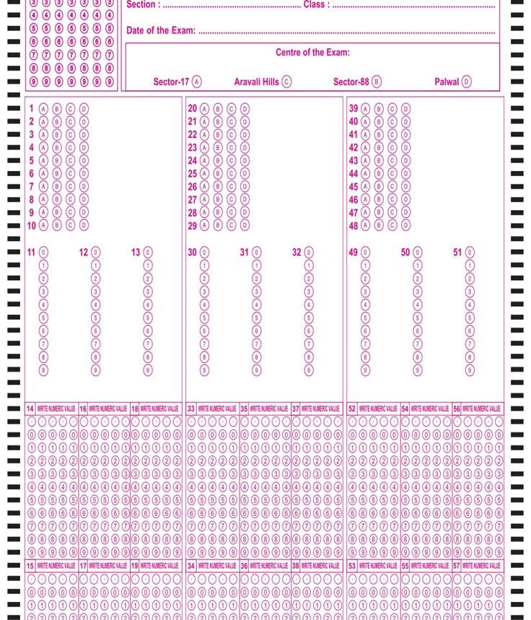
OMR System
Problem Statement
In educational institutions and assessment centers, manual grading of multiple-choice exams is a time-consuming and error-prone process.
The project aims to design and develop a robust and efficient OMR system that can accurately scan, interpret, and grade multiple-choice answer sheets.

Slide 3
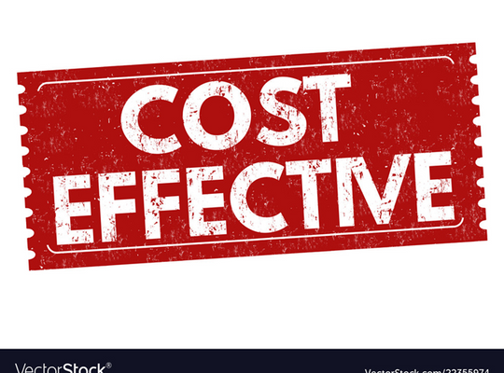
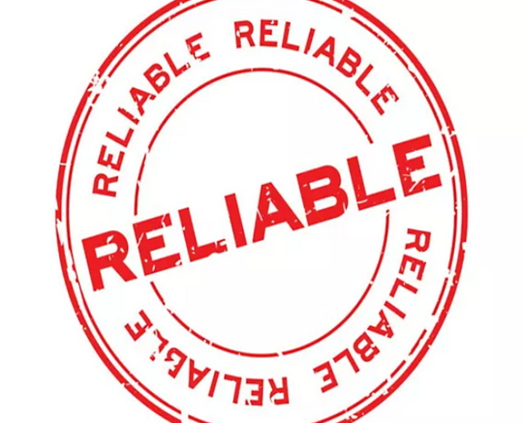
OMR System
Objectives
Create algorithm to accurately detect and interpret marked areas on the answer sheets. The system should be able to distinguish between valid marks, crossed-out marks, and other artifacts to ensure precise data extraction.
Major objective is to provide a scan accuracy of 100% in real-time.
Implement a grading mechanism that assigns scores based on the correct and incorrect answers, following predefined grading rules.
Create algo such that it can mark and recognize sheets in real-time , that is no need to upload answer sheet just put it in front of stable web cam.

Slide 4
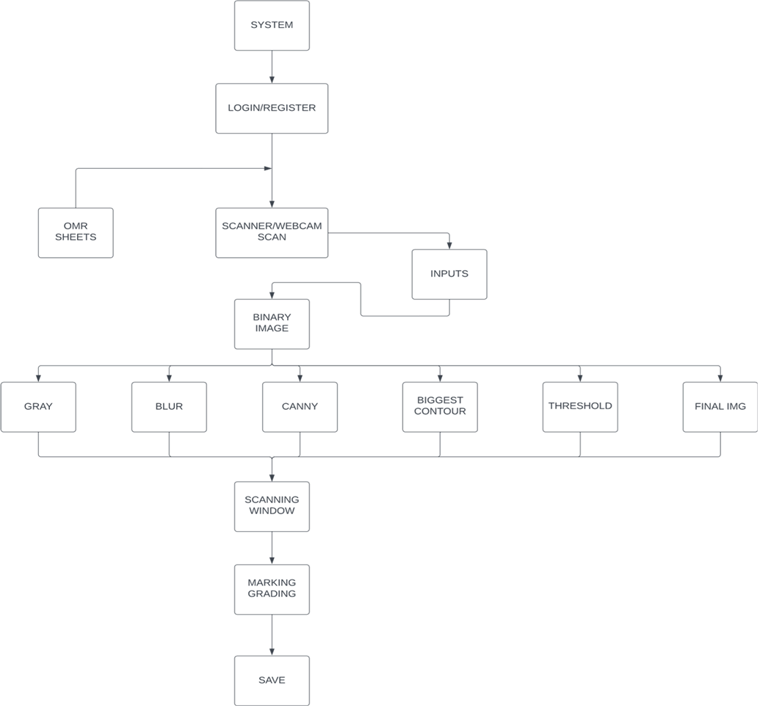
Architecture Diagram

Slide 5

OMR System
Technology Stack
Software Requirements: -
1. Python(cv2,MySQLconnector,numpy,pyautogui,os)
2. Flask libraries(session, render_template ,response,redirect, jasonify)
3. Mysql server and database
4. Web browser
5. For Front-end design (HTML , CSS , JAVAScript , Flask framework)
5. Working Webcam
7. Text editor (Vscode or Pycharm)
Hardware Requirements: -
1) CPU: core i5
2) RAM: 8.00 GB (7.68 GB usable)
3) STORAGE: 512 GB

Slide 6
OMR System
Implementation
The OMR System is divided majorly into following modules :
a) User- Interface
b) OMR-Sheet Capture
c) Image Pre-processing
d) Grading OMR in real-time
e) Download the OMR Sheet

Slide 7
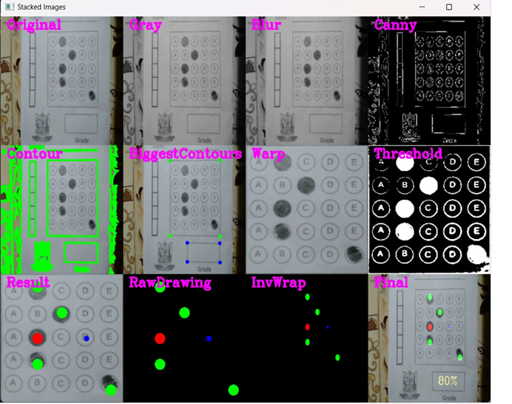
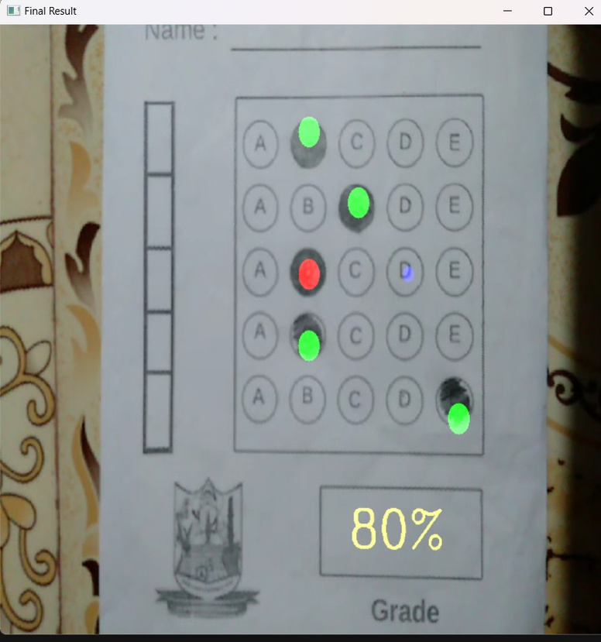
OMR System
Implementation
Image Pre-processing :

Slide 8
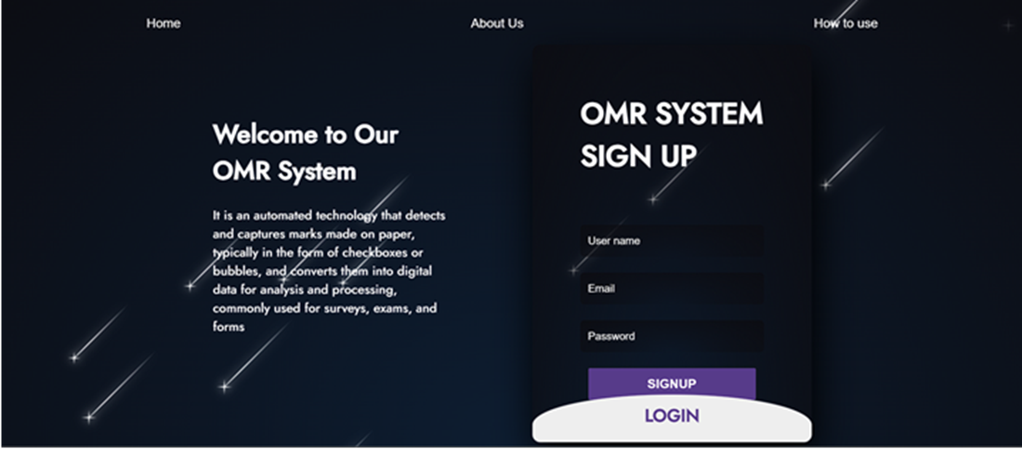
OMR System
Results

Slide 9
OMR System
Reference
1) Websites like OpenCV.org and scikit-image.org for tutorials on image processing and computer vision. (https://youtu.be/WQeoO7MI0Bs?si=UfVWSCPyrn4BdsUS)
2) Integrating HTML With FLASK Web Framework
(https://youtu.be/cWOpkTWg2vE?si=VzOceiiXncSQPZH9)
3) Joining Multiple Images to Display [5] | OpenCV Python Tutorials for Beginners
( https://www.computervision.zone/courses/learn-opencv-in-3-hours/ )
4) A Survey of Optical Mark Recognition Techniques R. Sinha , A.K. Arora , S. Sharma
published in 2012 , provides a comprehensive overview of OMR techniques and pre-processing classification methods .
5) Flask tutorial for beginners (https://www.geeksforgeeks.org/flask-tutorial/)

Slide 10
OMR System
THANK YOU

